Slide 1
Globus for Data Management
Rachana Ananthakrishnan
ranantha@uchicago.edu
February 28 2017

Slide 2
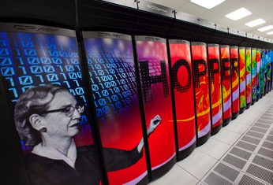
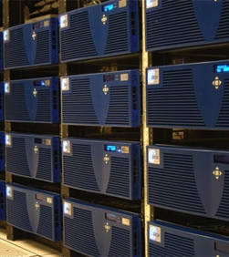
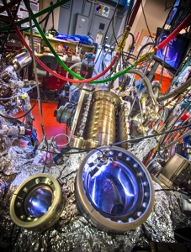



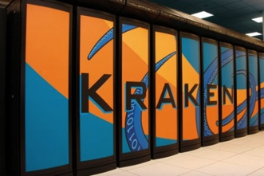


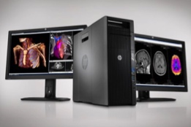

Globus SaaS
Compute Facility
Instrument
Globus transfers files reliably, securely
Globus controls access to shared files on existing storage; no need to move files to cloud storage!
4
2
Curator reviews and approves; data set published on campus or other system
Transfer
7
3
Share
1
Researcher selects files to share, selects user or group, and sets access permissions
6
Researcher initiates transfer request; or requested automatically by script, science gateway
Researcher assembles data set; describes it using metadata (Dublin core and domain-specific)
Publication Repository
Collaborator logs in to Globus and accesses shared files; no local account required;
download via Globus
5
Only a Web browser required
Use storage system of your choice
Access using your campus credentials
Publish
6
8
Peers, collaborators search and discover datasets; transfer and share using Globus
Discover
Personal Computer

Slide 3
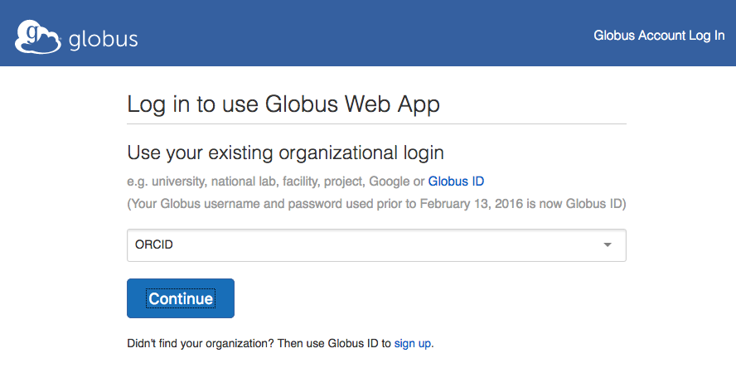
ORCID Login

Slide 4
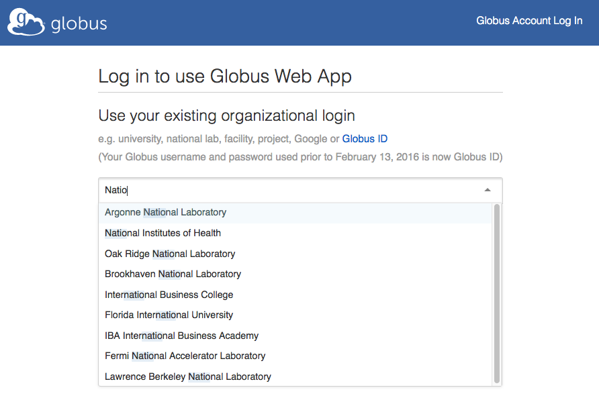
Institutional Login

Slide 5
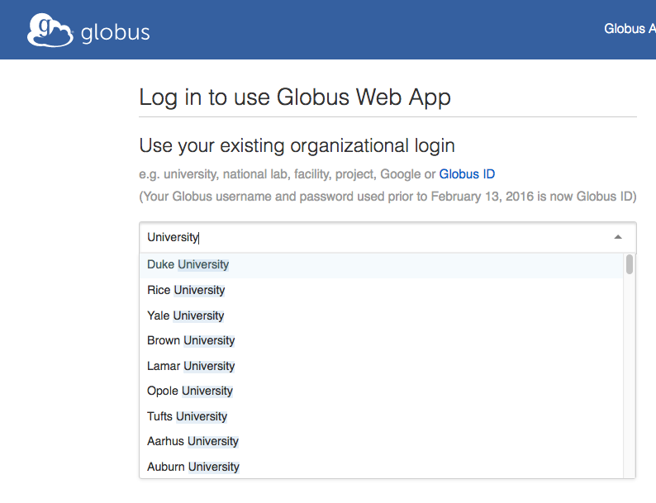
University Login

Slide 6
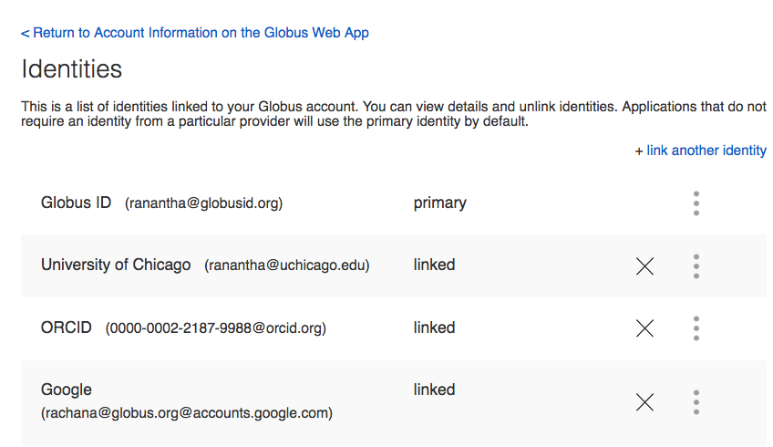
Linking identities

Slide 7
Linking identities

Slide 8
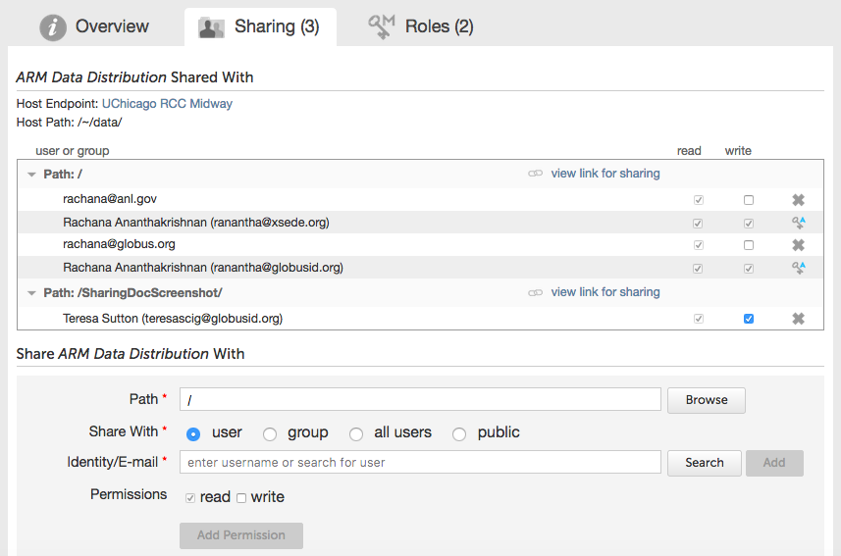
Sharing with any identity or email

Slide 9
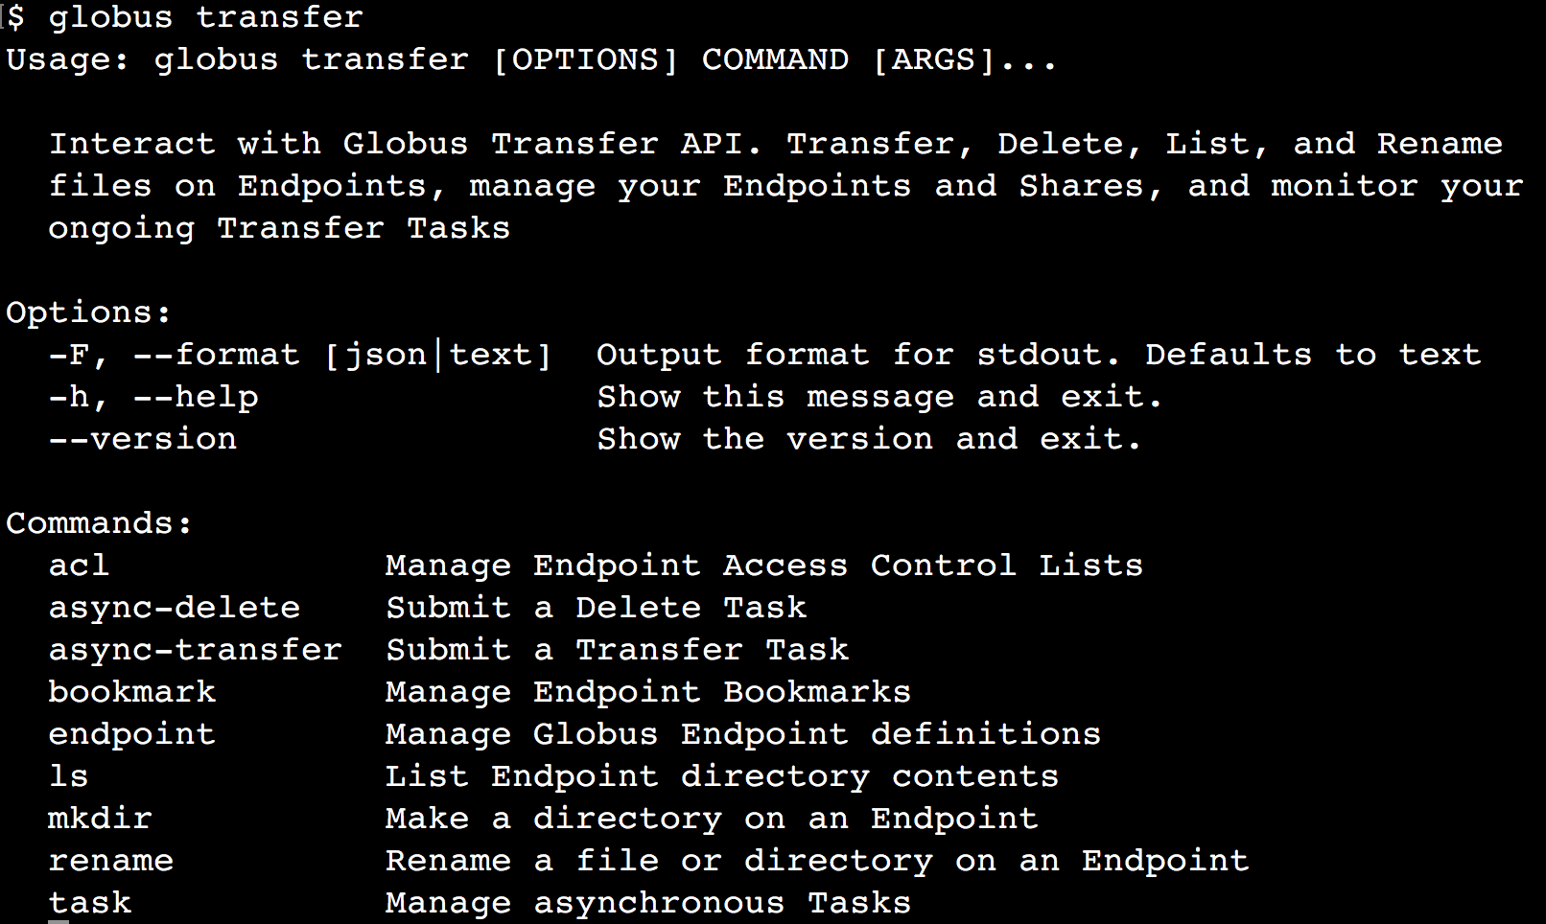
New Globus CLI (Beta)

Slide 10
Storage connectors
Standard storage connectors (Posix)
Linux, Windows, MacOS
Lustre, GPFS, OrangeFS, etc.
Premium storage connectors
HPSS
S3
Ceph RadosGW (S3 API)
Spectra Logic BlackPearl
Google Drive
Planned
HDFS
iRODS

Slide 11
Platform Questions
How do you leverage Globus services in your own applications?
How do you extend Globus with your own services?
How do we empower the research community to create an integrated ecosystem of services and applications?

Slide 12











Globus PaaS
Globus APIs
…
Globus Connect
Data Publication & Discovery
File Sharing
File Transfer & Replication
Auth & Groups
Globus Toolkit

Slide 13
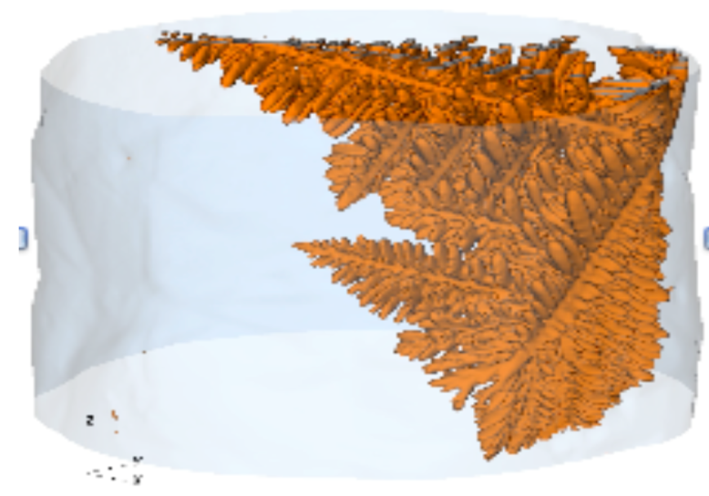
APS Beamline
DMagic @ APS
Automation of secure data management at the beamline
Integrated with APS accounts
1 person, supports 100s of people and PBs data, 1000 LOC, enabled by Globus SaaS
Francesco de Carlo, Advanced Photon Source
Notes:
-- X-ray imaging at Advanced Photon Source provides unprecedented resolution at nano-scale and beyond
-- Dynamic imaging will generate >200TB per dataset
-- Time-bounded access to instrument and resulting data – move it or lose it!
-- SaaS makes it possible to access and share data among collaborators

Slide 14
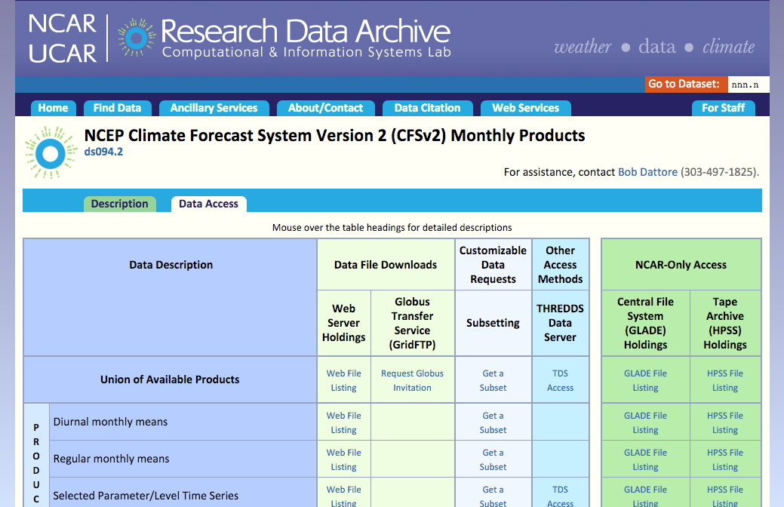
Example: NCAR RDA
Notes:
10TB – 50TB datasets
Do data slicing on these offline and share subsets of these

Slide 15
Globus Platform-as-a-Service
Globus APIs
…
Globus Connect
Data Publication & Discovery
File Sharing
File Transfer & Replication
Auth & Groups
Globus Toolkit

Slide 16
Globus Transfer API
Nearly all Globus Web App functionality implemented via public Transfer API
docs.globus.org/api/transfer
Notes:
Show the docs.globus.org site
GO TO “Task Management”
Show “GET Task by ID”

Slide 17
Globus Platform-as-a-Service
Globus APIs
…
Globus Connect
Data Publication & Discovery
File Sharing
File Transfer & Replication
Auth & Groups
Globus Toolkit

Slide 18
Globus Auth
Foundational identity and access management (IAM) platform service based on web standards
Users encounter intuitive interfaces with common look and feel across different services
Makes it easy for individuals, teams, and institutions to create web applications for the science community
Not deal with complexity of the associated security protocols
Use reliable, scalable, and highly-available system

Slide 19













Globus Auth Features
Service (Resource Server)
Least privilege model
App (Client)
User
App identity and authentication
Resource server
operator
Dependent service security
Globus Auth
(Authorization Server)
Native, mobile and web applications
Dependent Services (Resource Servers)
Dependent Services (Resource Servers)
Federated identities
Identity providers

Slide 20
Globus Auth
Identity and access management PaaS
docs.globus.org/api/auth
Introduction
Reference
Notes:
Show the Docs site

Slide 21
Globus Python SDK
Python client library for the Globus Auth and Transfer REST APIs
globus.github.io/globus-sdk-python
Public beta, likely to change some
Notes:
Go to URL
IT’s Open Source
Show it in Github repo

Slide 22
Python SDK Jupyter notebook
Jupyter (iPython) notebook demonstrating use of Python SDK
github.com/globus/globus-jupyter-notebooks
Overview
Open source
Notes:
Jupyter notebook has examples that show many of the common API calls
DO THE INSTALLATION on localhost
Tell them they will do this in a little bit
Talk about the first few steps in the notebook
Endpoints and their IDs + display names (tie them back to the web UI for reference)
Talk about the Globus Tutorial endpoints
Logging in and getting a TOKEN

Slide 23
Globus Auth - Examples
Tutorials
https://www.globusworld.org/workshop2016
Native applications
https://github.com/globus/native-app-examples
Modern Data Portal
https://github.com/globus/globus-sample-data-portal.git
https://globus.computationinstitute.org/

Slide 24
Globus Platform-as-a-Service
Globus APIs
…
Globus Connect
Data Publication & Discovery
File Sharing
File Transfer & Replication
Auth & Groups
Globus Toolkit

Slide 25
Thank You
More information
Globus.org
Docs.globus.org
Contact
support@globus.org
rachana@globus.org
greg@globus.org
Globus meeting at Oak Ridge
March 14th and 15th

